Slide 1
Time Series
Lecture 6
David Nagy, Mohan Sukumar

Slide 2
Learning Objectives
Working with Dates and Times in Python
What is time series?
Time series terminology
Time Series Analysis
Decomposition of Time Series
Additive and Multiplicative Time Series
Stationary and Non-Stationary Time Series
Time Series analysis techniques

Slide 3
Working with Dates and Times in Python

Slide 4
Definitions of Date and Time
Date: Handles dates without time
POSIXct: Handles date & time in calendar time (ct)
POSIXlt: Handles date & time in local time (lt)
Hms: Parses periods with hour(h), minute(m), and second(s)
Timestamp: Represents a single pandas date & time
Interval: Defines an open or closed range between dates and time
Time delta: Computes time difference between different datetimes

Slide 5
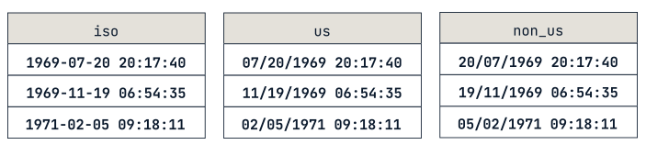
ISO8601 datetime format
Standardization of working with time:
YYYY-MM-DD HH:MM:SS TZ
Y -year, M-month, D-day,
H - hour, M - minute, S - second,
TZ - timezone

Slide 6

Usage of Date and Time
Useful libraries: datetime, time, pytz, pandas & many … many more
Cheatsheet: LINK

Slide 7
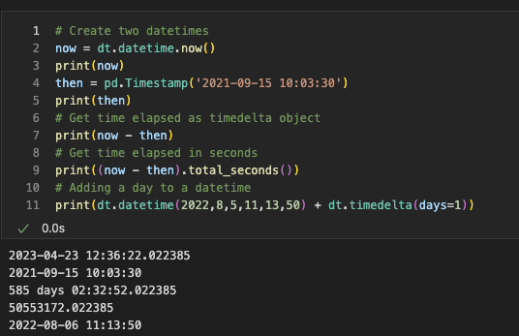
Arithmetic with Date and Time

Slide 8
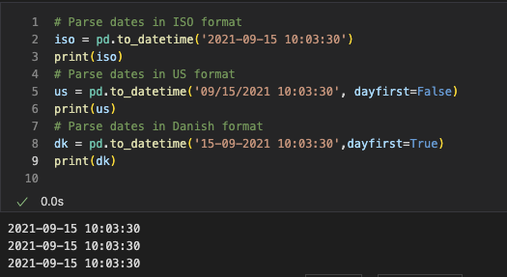
Parsing dates, datetimes, and times

Slide 9
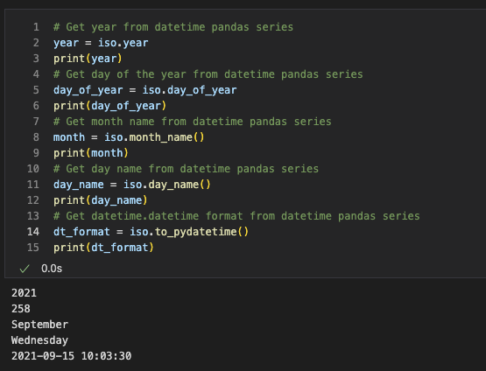
Extracting datetime components

Slide 10

Break

Slide 11
What is Time Series

Slide 12
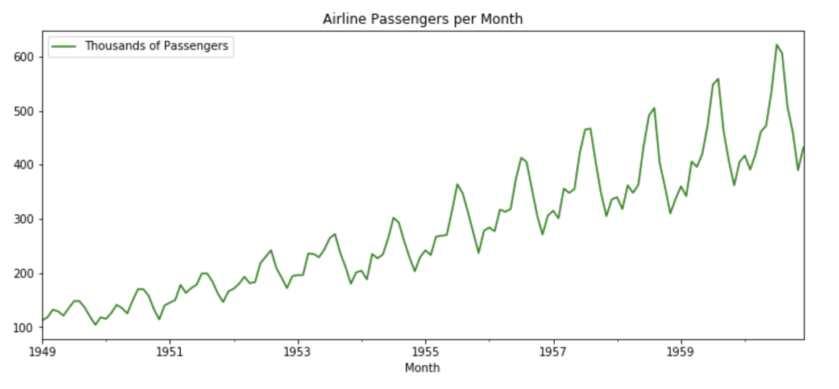
Time Series
Sequence of data points ordered in time
Typically measured at regular intervals.
Visualized using line charts or time plots,
Data points plotted against time on the x-axis.

Slide 13
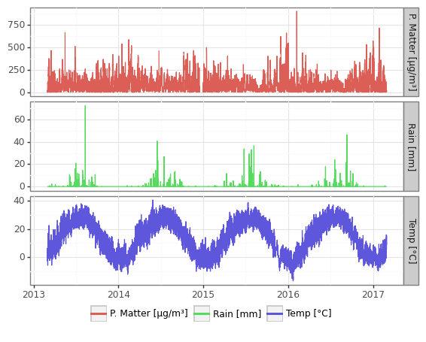
Univariate - Multivariate
One-dimensional or multidimensional (several variables measured over time).
Patterns or trends in the data (seasonal fluctuations or long-term trends)

Slide 14
Time Series Terminology

Slide 15
Terminology
Time interval: The frequency at which the data points are collected, such as hourly, daily, weekly, or monthly.
Time stamp: The specific time and date when a data point was collected.
Trend: The long-term increase or decrease in the data over time.
Seasonality: Regular and predictable fluctuations in the data that occur at fixed intervals, such as daily, weekly, or monthly.
Cyclicity: Longer-term periodic patterns in the data that do not occur at fixed intervals.
Stationarity: A time series is stationary if its statistical properties, such as mean and variance, remain constant over time.
Autocorrelation: The correlation between a time series and a lagged version of itself.
White noise: A time series where each data point is a random and uncorrelated value with a constant mean and variance.
Moving average: A smoothing technique that averages out fluctuations in the data to highlight underlying trends.

Slide 16
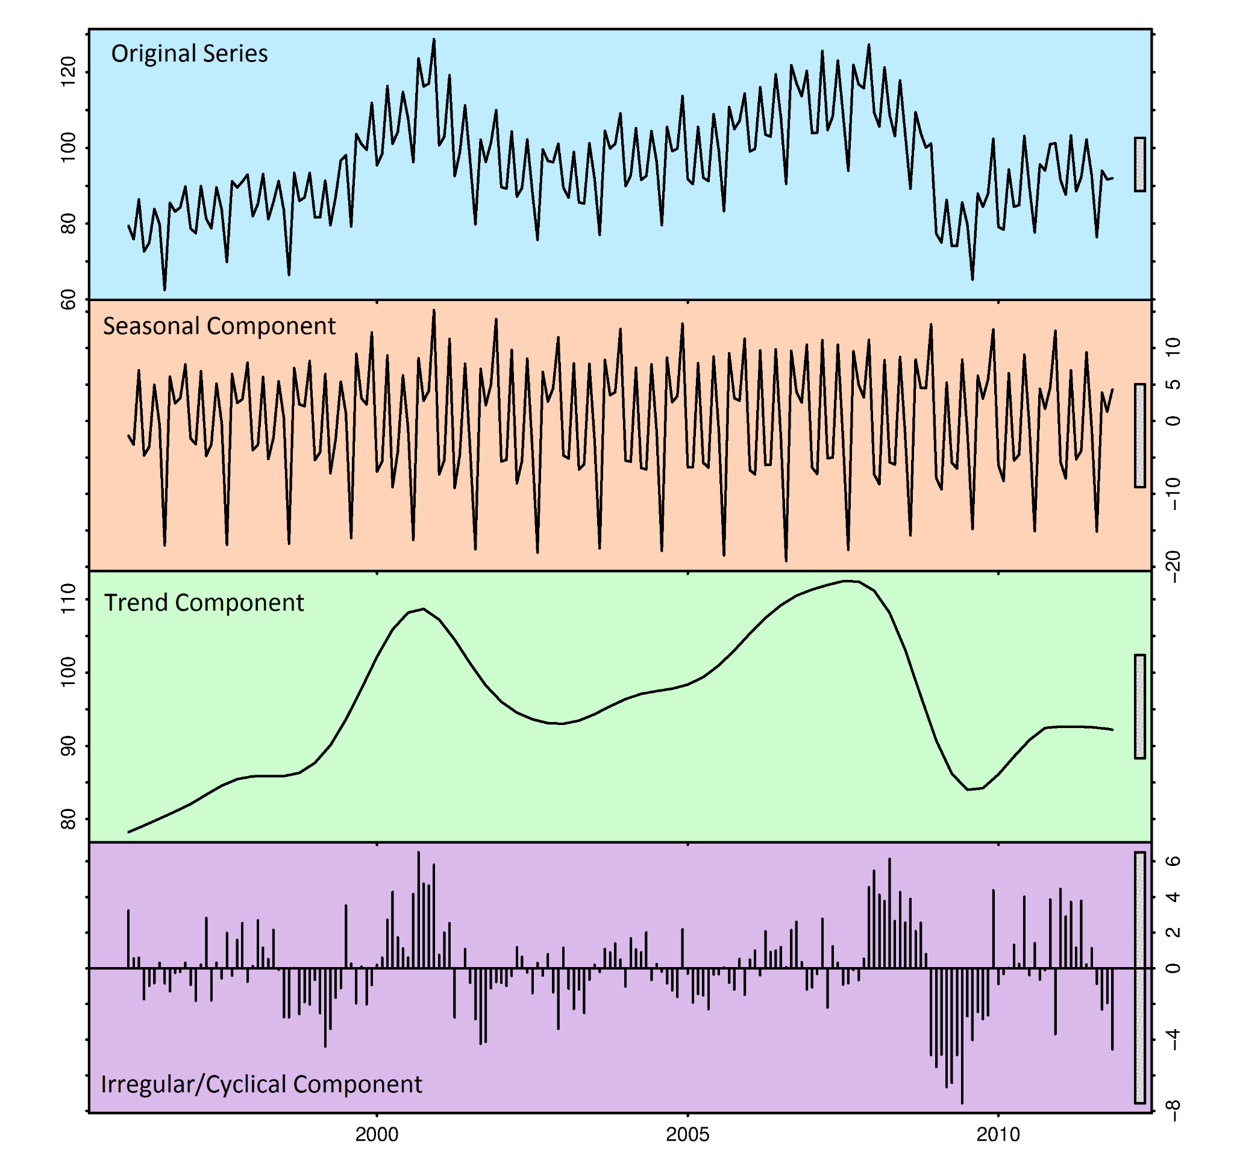
Terminology

Slide 17
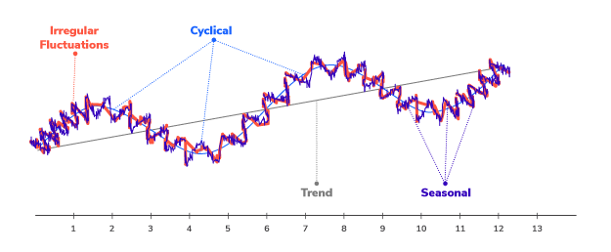
Terminology

Slide 18
Time Series Analysis

Slide 19
Break

Slide 20
Decomposition of Time Series

Slide 21
Decomposition of Time Series
The process of breaking down the observed data into its constituent parts, such as trend, seasonal, and random components.

Slide 22
Additive and Multiplicative Time Series

Slide 23
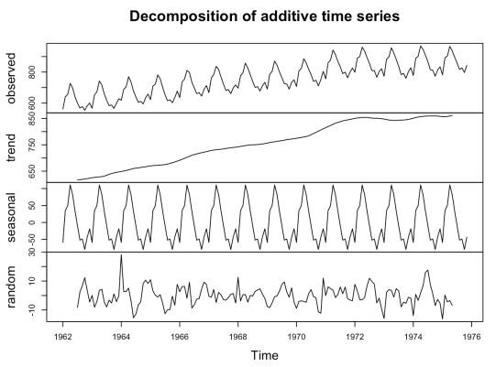
Additive Time Series
Model assumes that the trend, seasonality, and random noise components of the time series are additive.
Y(t) = T(t) + S(t) + e(t)

Slide 24
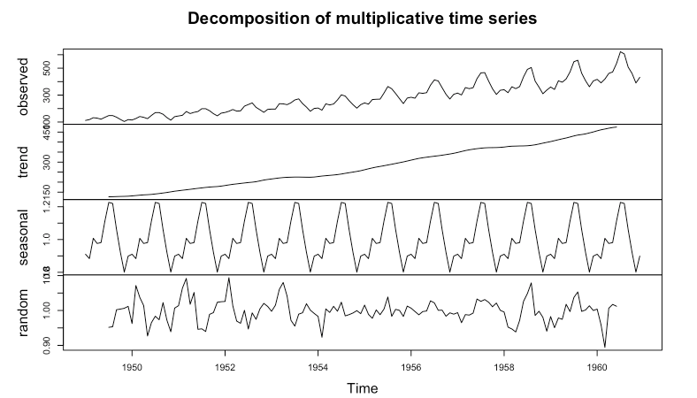
Multiplicative Time Series
Model assumes that the trend, seasonality, and random noise components of the time series are multiplicative.
Y(t) = T(t) * S(t) * e(t)

Slide 25
Stationary vs Non Stationary
Time Series

Slide 26
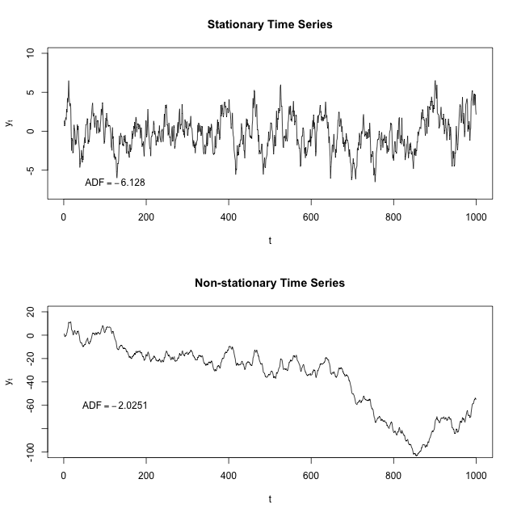
Stationary vs Non Stationary

Slide 27
Stationary Time Series

Slide 28
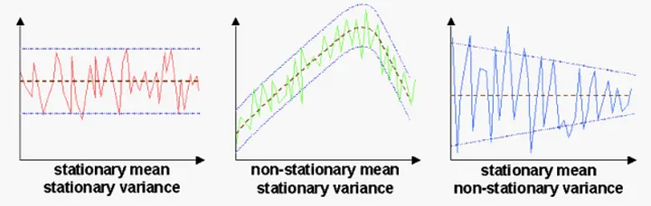
Stationary Time Series
Statistical properties, such as mean and variance, remain constant over time.
Why is this important?
Easier to analyze
Most statistical model and technique assumes the data generated by stationary processes.

Slide 29
Non Stationary Time Series

Slide 30
Non Stationary Time Series
Statistical properties, such as mean and variance, changes over time.
Why is this important?
Underlying in relationship between datapoints can bias the modelling.
Trending time series: upward or downward trend over time.
Seasonal time series: regular seasonal patterns,
Cyclical time series: irregular, non-seasonal cycles over time.
Random walk time series: each observation is a random deviation from the previous observation.

Slide 31
How to test for stationarity?

Slide 32
How to test for stationarity?
Looking at the plot of the series.
Split the series into 2 or more continuous parts and computing the summary statistics and the autocorrelation.
There are several quantitative methods we can use to determine if a given series is stationary or not.
Augmented Dickey Fuller test (ADF Test)
Kwiatkowski-Phillips-Schmidt-Shin – KPSS test (trend stationary)
Philips Perron test (PP Test)

Slide 33
Break

Slide 34
Time Series Analysis Techniques

Slide 35
Differencing

Slide 36
Differencing
A technique used in time series analysis to remove the dependence of the observations on time.
Help stabilize the mean of the time series by removing the trend.
Help remove the seasonal component.
After differencing, the resulting time series is said to be stationary.

Slide 37
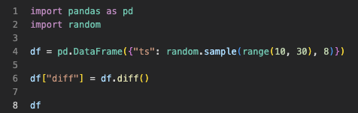
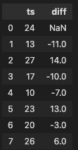
Differencing
The first-order difference - is the difference between the current observation and the previous observation.
The second-order difference - is the difference between the first-order difference and the previous first-order difference, and so on..
diff() method in pandas to perform differencing.
( the default value of periods=1 is used to compute the difference between consecutive values)

Slide 38
Detrend and Deseasonalize

Slide 39
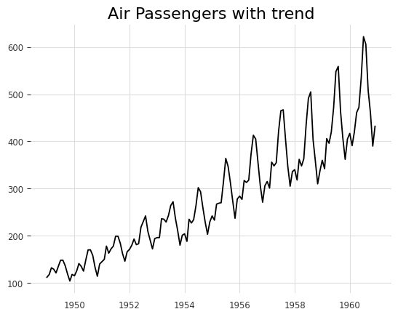
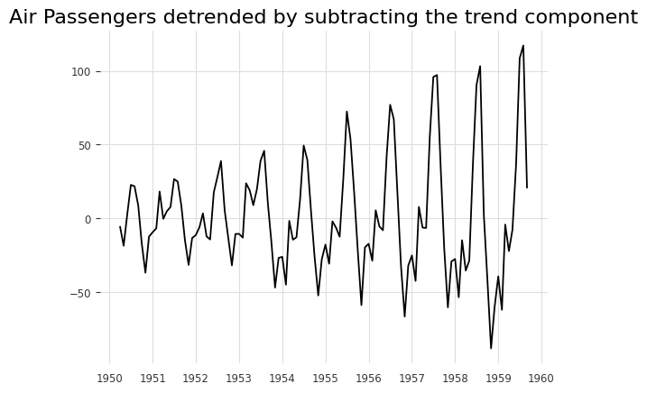
Detrending
It means to remove the trend component from the time series

Slide 40
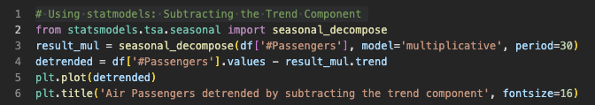
Detrending
It means to remove the trend component from the time series

Slide 41
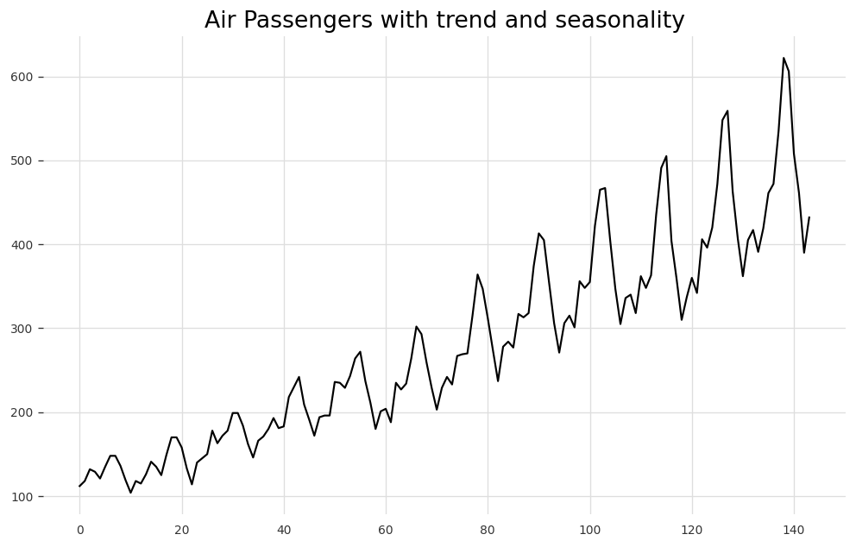
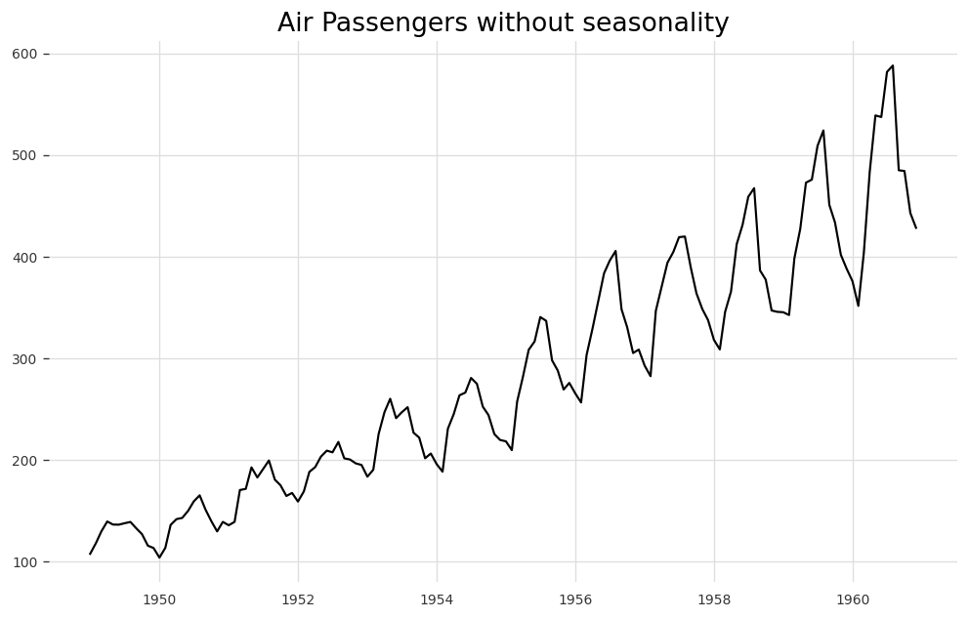
Detrending
It means to remove the seasonal component from the time series

Slide 42
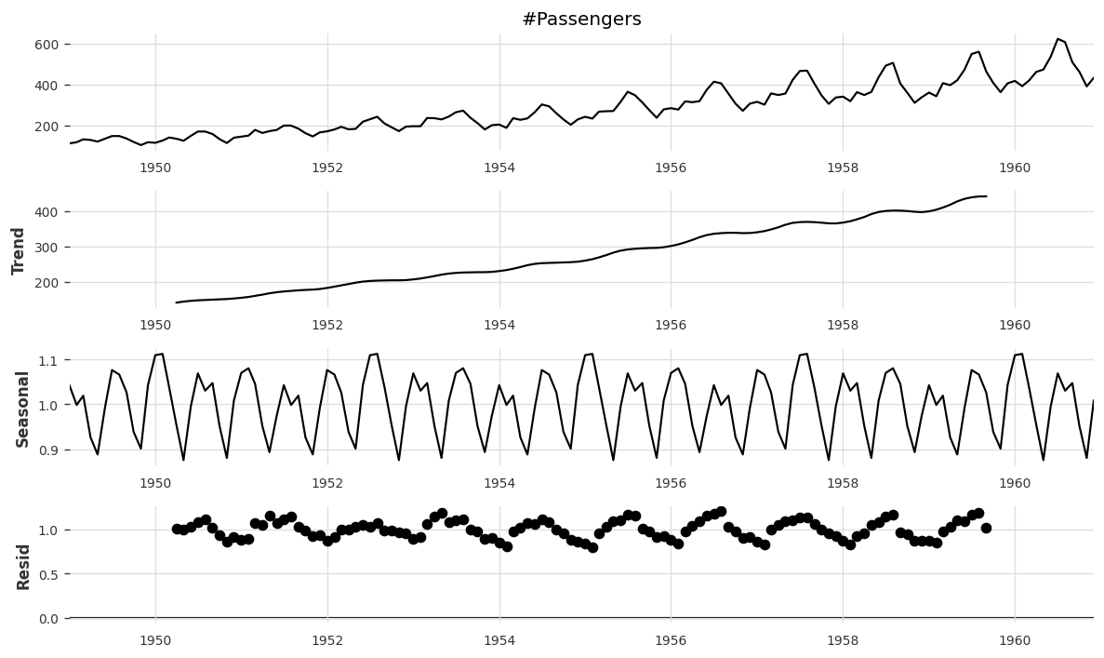
Complete decomposition

Slide 43
Autocorrelation

Slide 44
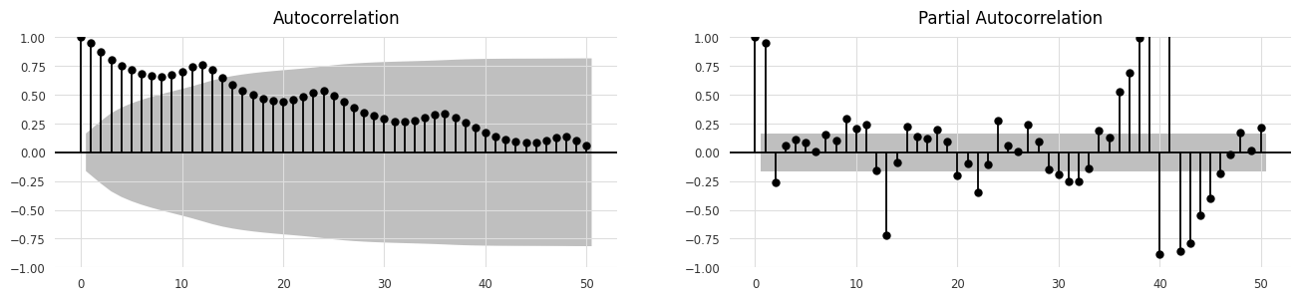
Autocorrelation and Partial Autocorrelation

Slide 45

WE DID IT!

